Slide 1
Update
1/21

Slide 2
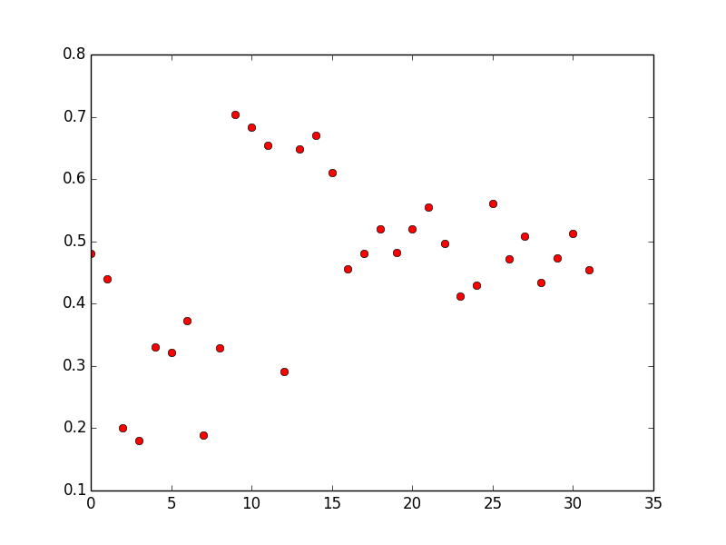
IP distribution

Slide 3
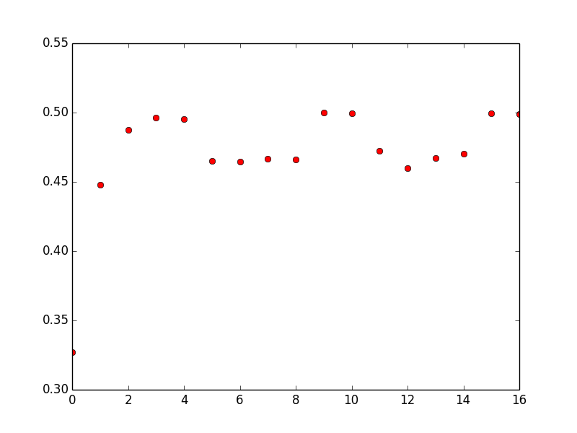
Time Attach Distribution

Slide 4
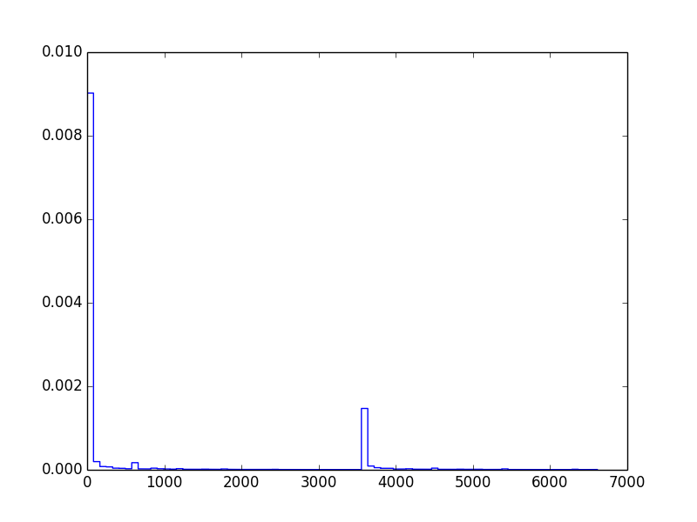
Duration Distribution
minmax=(0, 83841), mean=1153.8843298302818, variance=10780759.839966381, skewness=7.442477835976355, kurtosis=87.7463144706822)

Slide 5
New Model
# Sessions
Time of Attachment
Duration of Attachment

Slide 6
Number of Sessions
#Sessions
IP
Date
Device
Day of Week, etc

Slide 7
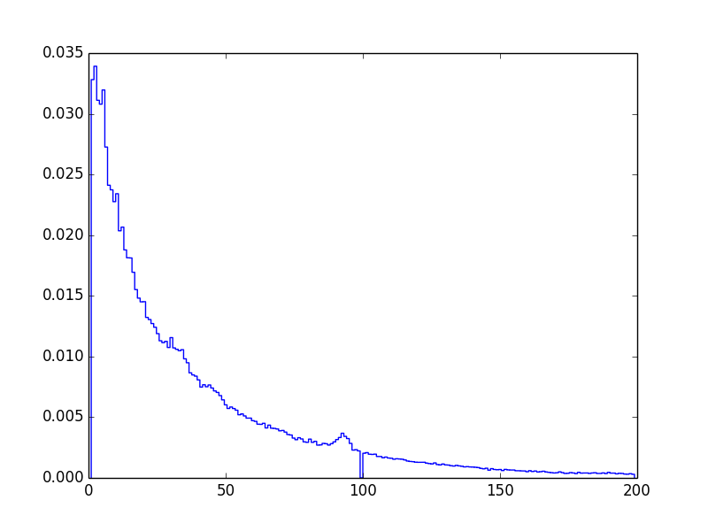
Distribution of #Sessions

Slide 8
Outcome
Fitted various models for #Sessions
Normal (bad)
Exponential (okay)
Pareto (best)
Skew Normal is not available
This is done through giving a uniform distribution over the parameters that decide the e.g. normal distribution. Use find_MAP() to estimate optimal parameter values (mu, sigma) given the observed data. Compare the error loss to see which model is better.

Slide 9
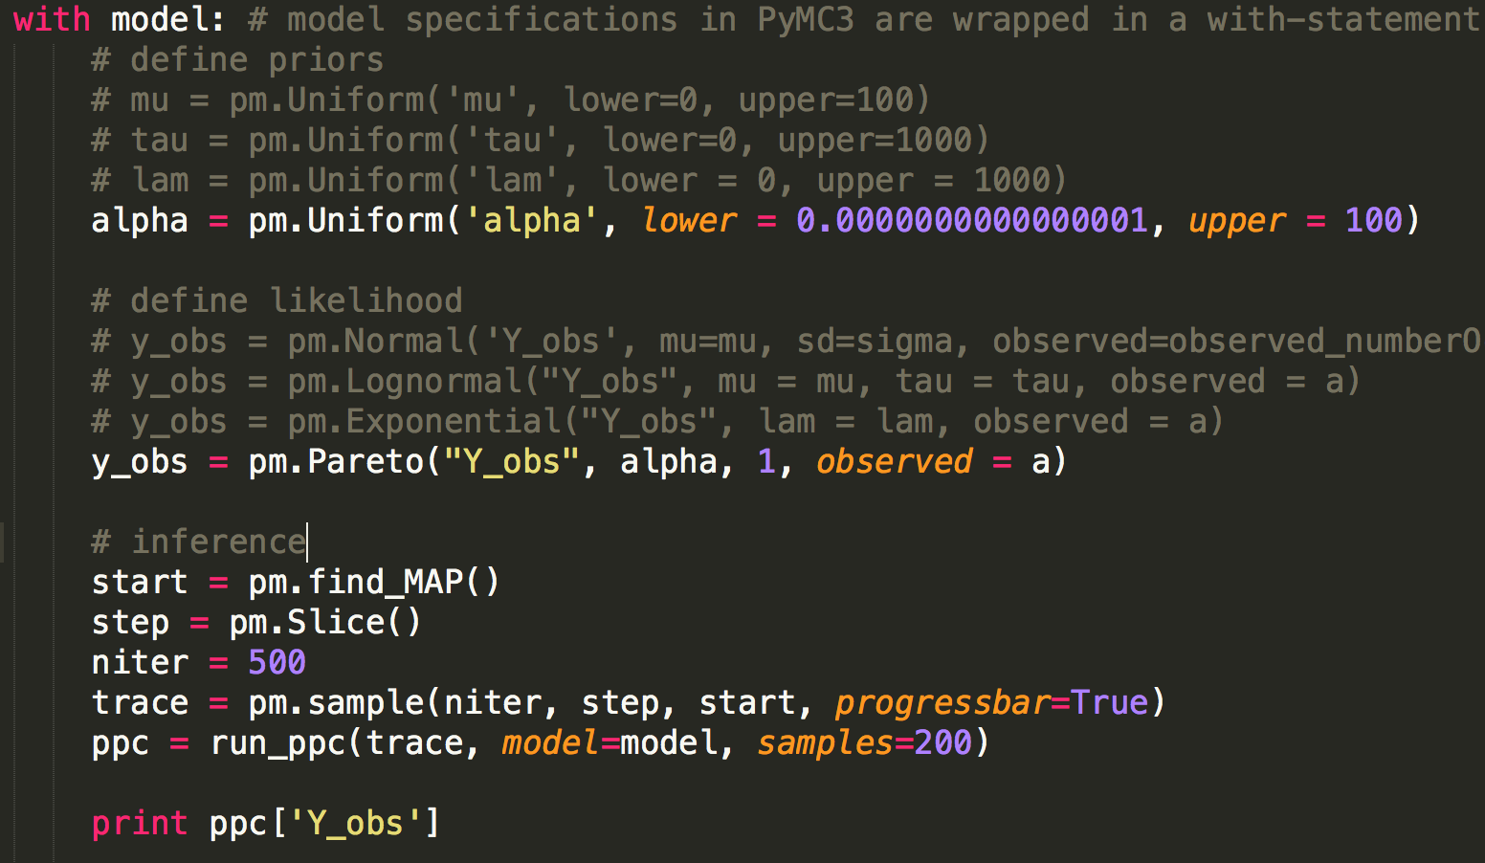

Slide 10
Challenge (Stuck point)
The conditional probabilities seem to be rather difficult to implement in pymc3.
http://healthyalgorithms.com/2011/11/23/causal-modeling-in-python-bayesian-networks-in-pymc/

Slide 11
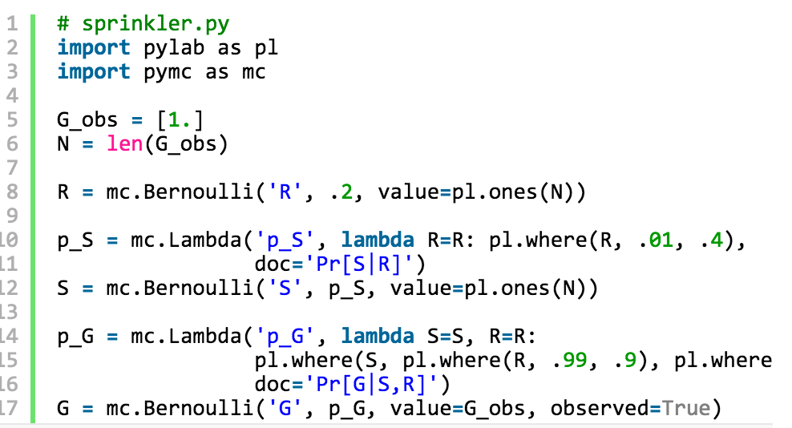
Example Conditional Prob.

Slide 12
This requires the user to calculate the conditional probabilities

Slide 13
Time of Attachment
Time Attach
IP
Date
Device
Day of Week, etc
#Sessions

Slide 14
Duration
Duration
IP
Date
Device
Day of Week, etc
#Sessions
Time attach

